Slide 1
FAKE NEWS DETECTION
Submitted in the partial fulfillment for the award of the degree of BACHELOR OF ENGINEERING
IN
COMPUTER SCIENCE WITH SPECIALIZATION
IN
INFORMATION SECURITY
Submitted by:
CHINNARI ABHISHEK 21BCS3692
MENDA MANMADHA RAO 21BCS3544
PENTAKOTA SRI PRANEETH 21BCS3523
YADALA CHANDU 21BCS11015
Under the Supervision of:
Ms. Komal Mehta
Department of AIT-CSE
DISCOVER . LEARN . EMPOWER

Slide 2
Outline
Introduction to Project
Problem Formulation
Objectives of the work
Methodology used
Conclusion
Future Scope
References

Slide 3

INTRODUCTION
Fake news is false information presented as news with the intent of causing harm or generating revenue.
Social media platforms, particularly Facebook, have made it easier for fake news to spread.
Detecting fake news is difficult because it can be presented in a convincing manner.

Slide 4
INTRODUCTION
The proposed approach in the paper is to examine news headlines to predict whether they are fake or not.
Fake news can be an effective marketing strategy, but it can also cause harm to individuals and society.
The profits from spreading fake news may not justify the harm it causes.

Slide 5

PROBLEM FORMULATION
The World Wide Web and social media platforms like Facebook and Twitter have transformed how information is disseminated.
News outlets can provide near-real-time updates to subscribers due to digital media formats.
The evolution of news media has made it easier for consumers to access the latest news.

Slide 6
PROBLEM FORMULATION
Facebook drives 70% of traffic to news websites.
Social media platforms can facilitate discussion, sharing of ideas, and debate over important issues.
However, some entities use social media negatively for monetary gain or to spread biased opinions, manipulate mindsets, and disseminate fake news.

Slide 7

OBJECTIVES
Identifying sources and developing real-time fake news detection in videos is still a challenge.
Computational techniques and a hybrid approach may help detect and classify deceptive articles.
Computational techniques such as natural language processing and social network analysis can help fake news.

Slide 8
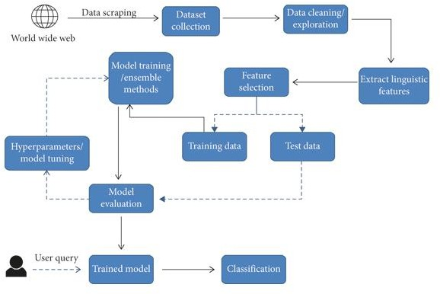
METHODOLOGY

Slide 9
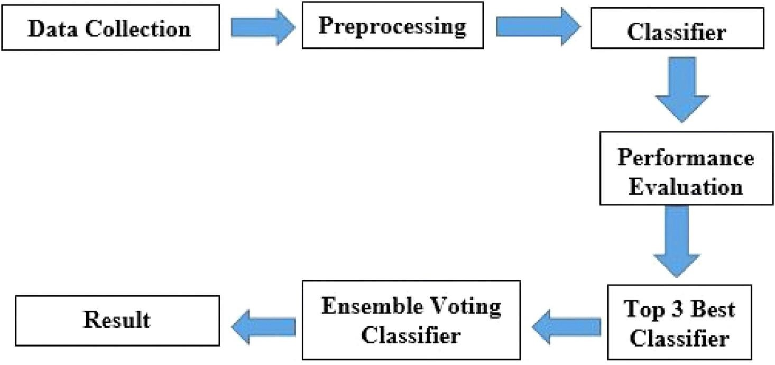

Slide 10
RESULT
After running several simulations, following are the results of
our model :
Confusion matrix for passive aggressive classifier :
Accuracy - 93.29%
 | FAKE | REAL
FAKE | 571 | 44
REAL | 41 | 611

Slide 11

RESULT
we will develop a predictive system using
Python and machine learning to identify fake
news.
The system will utilize a dataset file, and when provided with a news article,it will predict whether the article is genuine or fabricated.
If the output is 0, the article is considered real, and if the output is 1,
the article is considered fake.

Slide 12
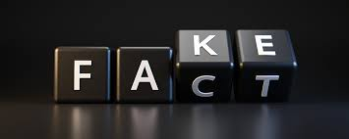
CONCLUSION
Machine learning algorithms and natural language processing techniques can help in identifying patterns and characteristics of fake news.
A combination of technological and human approaches is required to effectively combat the spread of fake news.
Detecting fake news is a complex task that requires a multifaceted approach.
In conclusion, addressing the issue of fake news requires a collaborative effort from both technology and human experts.

Slide 13
FUTURE SCOPE
Integration of real-time detection algorithms that can identify and flag fake news as soon as it is published.
Expansion of the project to detect fake news in videos and images, not just textual content.
Collaboration with social media companies and news outlets to integrate fake news detection tools into their platforms and increase the speed and efficiency of detecting and removing fake news.
Development of a comprehensive database of known fake news sources and patterns that can be used to enhance the accuracy of detection algorithms.

Slide 14
REFERENCES
[1] Gupta, R., Tiwari, A., & Sengar, V. S. (2020). Detecting Fake News in Social Media Networks. 2020 5th International Conference on Computing, Communication and Security (ICCCS), 1-5. DOI: 10.1109/CCCS49291.2020.9209599
[2] Chen, S. Y., & Hua, K. L. (2019). Fake news detection on social media: A data mining perspective. ACM Transactions on Multimedia Computing, Communications, and Applications (TOMM), 15(2), 1-20.
[3] Rohatgi, S., & Arora, G. (2020). A Survey of Fake News Detection Methods: Algorithms, Evaluations, and Future Directions. ACM Transactions on Intelligent Systems and Technology (TIST), 11(3), 1-40.
[4] Liu, C., & Liu, H. (2018). Fake news detection on social media: A review. Data Science and Engineering, 3(1), 1-21. DOI: 10.1007/s41019-017-0051-1.
[5] Bilal, M., Ahmed, S., & Ahmed, Z. (2020). Combating Fake News: A Survey on Detection and Mitigation Techniques. IEEE Access, 8, 188102-188123. doi: 10.1109/access.2020.3030090
[6] D. Holan, 2016 Lie of the Year: Fake News, PolitiFact, Washington, DC, USA,2016.
[7] D. M. J. Lazer, M. A. Baum, Y. Benkler et al., “The science of fake news,”Science,vol. 359, no. 6380, pp. 1094–1096, 2018.View at: Publisher Site | Google Scholar
[8] S. Kogan, T. J. Moskowitz, and M. Niessner, “Fake News: Evidence fromFinancialMarkets,” 2019, https://ssrn.com/abstract=3237763.View at: Google Scholar

Slide 15
REFERENCES
[9] A.Robb, “Anatomy of a fake news scandal,” Rolling Stone, vol. 1301, pp. 28–33,2017.View at: Google Scholar
[10] J. Soll, “The long and brutal history of fake news,” Politico Magazine, vol. 18, no.12, 2016.
[11] N. K. Conroy, V. L. Rubin, and Y. Chen, “Automatic deception detection: methodsfor finding fake news,” Proceedings of the Association for InformationScienceandTechnology, vol. 52, no. 1, pp. 1–4, 2015.
[12] F. T. Asr and M. Taboada, “Misinfotext: a collection of news articles, withfalseand true labels,” 2019.

